Slide 1
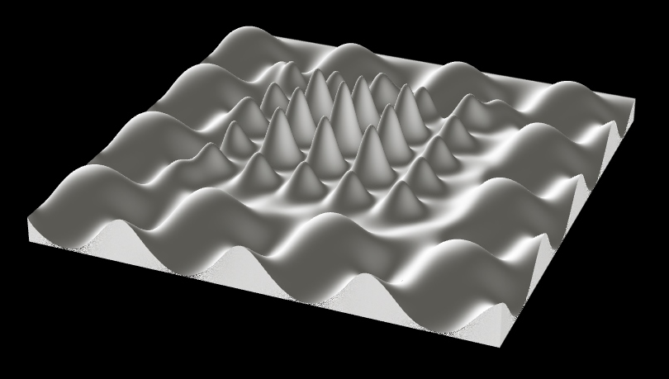
P1
<Computational Design Thinking>
<Parametric Design>
P1
BEST PICTURE
Assignment
Context
Course
Date
Parametric Design
Freshmore
Term 1
Computational
Design Thinking
2021
<Theme>
Difficult Times
<Description>
The objective of this project was to produce and generate a surface that is interesting and mapping its variation.
Due to the current pandemic, almost everywhere, the stress levels have gone up exponentially. Living in such a period, I seek to find a surface that would be able to describe both the stress and the desire for normalcy.
The piece shown on the right is an attempt to describe such a desire.
The outcomes also creates an image of mountain ranges which are difficult to move through, just like how the current pandemic situation is difficult to navigate away from.
Student
Darren Chan Yu Hao
100634
Instructor
Jason Lim
Instructor

Slide 2
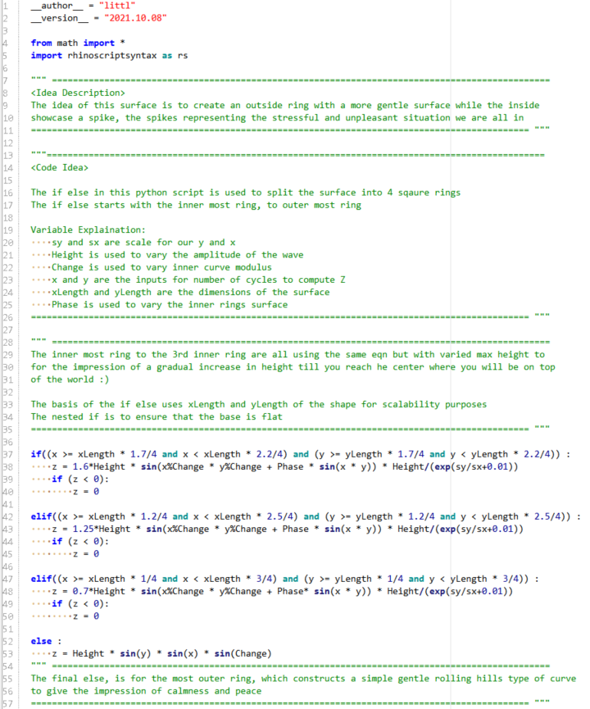
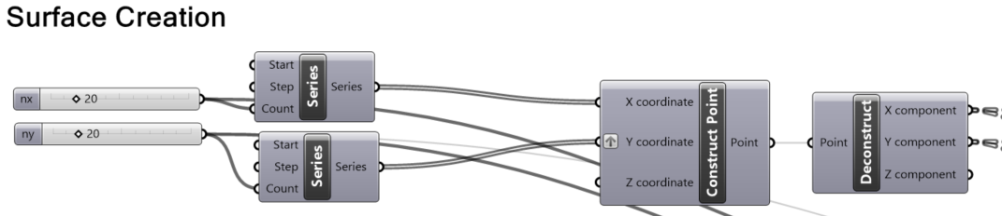
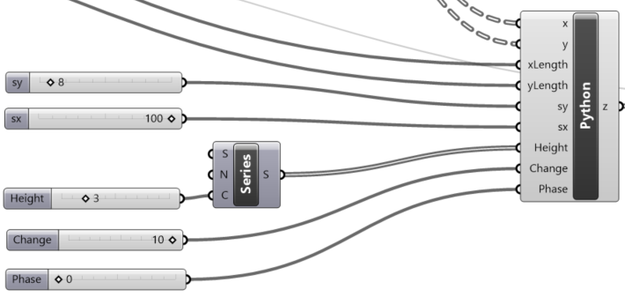
P2
<Computational Design Thinking>
<Parametric Design>
P2
<Grasshopper>
The grasshopper python component will take in 8 inputs:
X, y are the dimensions of the surface in series form.
xLength and yLength are the absolute dimension value of x and y
sx and sy are the scaling values for x and y
Height is to adjust the overall height of the surface
Change is used as a modulo operator parameter
Phase is also used as a variable parameter
Details shown in the script comment blocks
1/4
Captions
01 Inputs
02 Python Component
03 Code
1/4
03
01
02

Slide 3
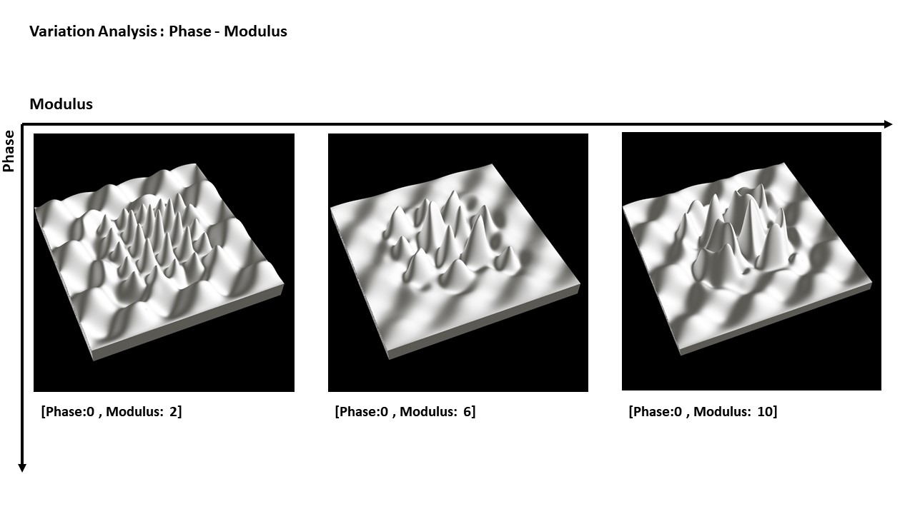
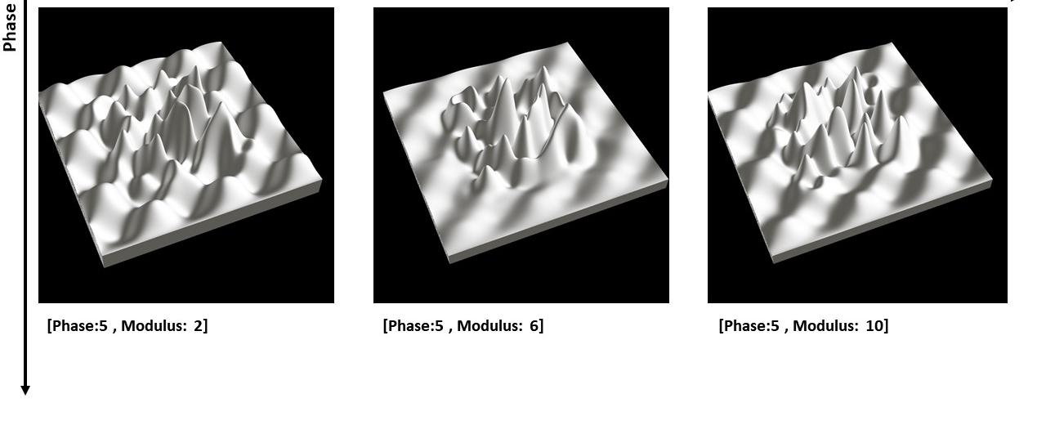
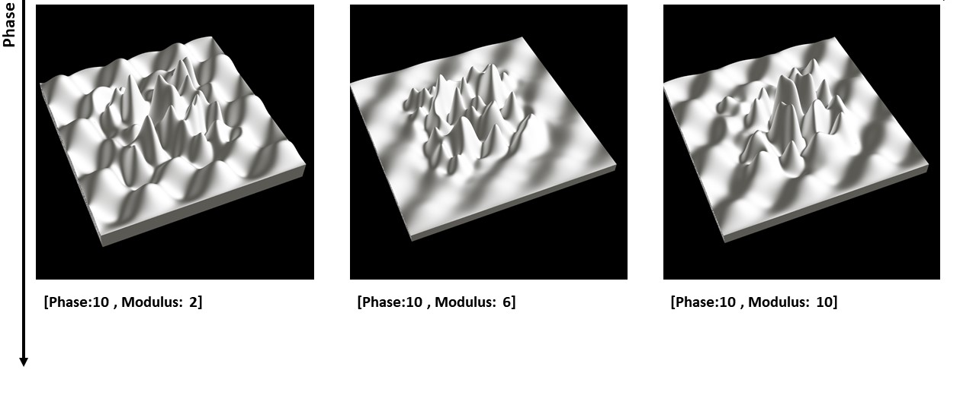
P3
<Computational Design Thinking>
<Parametric Design>
P3
<Variation Mapping>
As shown in code in the previous slide, there are two equations at play here for the “outer ring” and “inner ring”.
On this page, I showed the variation when changing the modulo operator for x and y and when changing the phase parameter for the inner rings.
There are interesting combinations of when varying these two parameter. Many of which showcases parametric generated mountain ranges that are pleasing to look at.
While increasing the mod and phase generally leads to more interesting and complex surfaces, it will also be potentially more difficult for the 3d printers to capture the surface perfectly and entirely. It can also get so massive that there is too much to focus on.
While these are very interesting in terms of quantitative method, I will discuss more on my desirability in the next page.
Captions
01 Variation Mapping
01

Slide 4
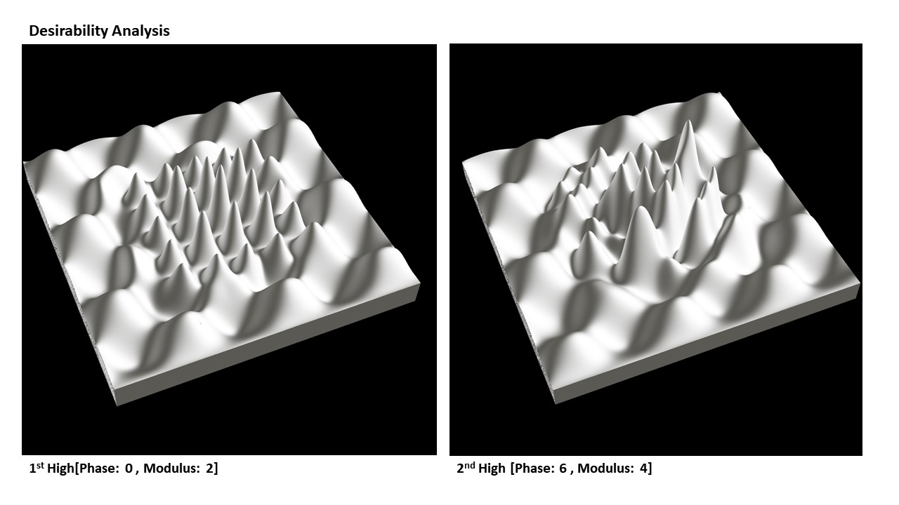
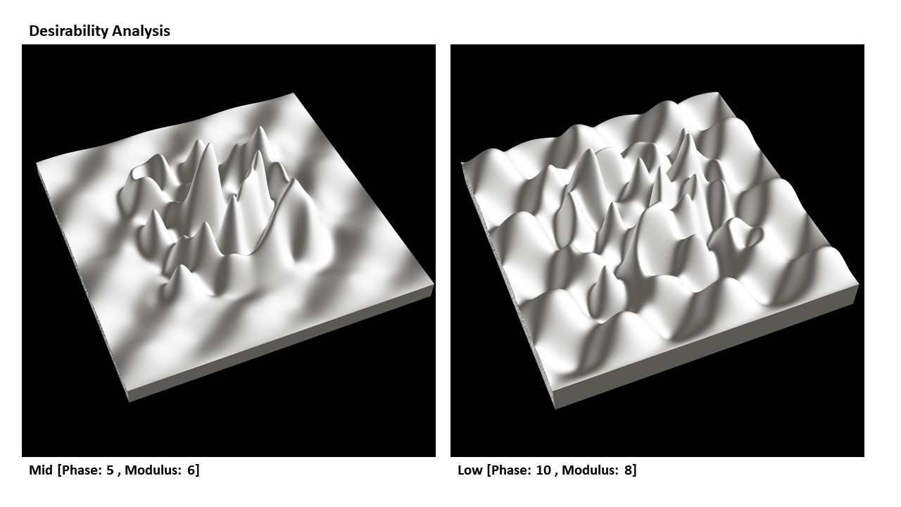
P4
<Computational Design Thinking>
<Parametric Design>
P4
1/2
<Desirability Mapping>
For what I desire for my surface. As mentioned, I wanted a sort of calm and gentle surface on the outside ring. This is to illustrate our old normal before the pandemic. These gentle curves flow easily where there are not much obstruction in the way. This reminds me how carefree and easygoing our lives were back then. We didn’t have to adhere to the many measures such as wearing mask outside, that we are now very used to.
That is not to say that there were no hardship previously. For students, it would be things like exams. For the adults, it would be like being able to pay the bills on time. Therefore, the most desirable option for me, would not be a completely flat surface on the outside, but a semi flat one.
The inner ring is then used to contrasts the outer ring. The inside is supposed to show a sort of increase in distress levels. It shows that we are right smack in the middle of a period where lives have gotten much more difficult. If you worked in the healthcare sector for example, the past ~2 years must have seen you overworking beyond belief.
Therefore, the desire is to have sort of high peaks to showcase this increase levels of difficulty beyond the norm. But I do not want a totally chaotic inside ring as well. With how things are now, the world has plans on opening back up. Things are slowly falling back into place.
While in the aesthetic page, there are some surfaces that might look more interesting and, in some ways, nicer, the design I desire for the inside ring was something that can also showcase what I described.
1/2
Captions
01 Desirability High
02 Desirability Mid - Low
01
02

Slide 5
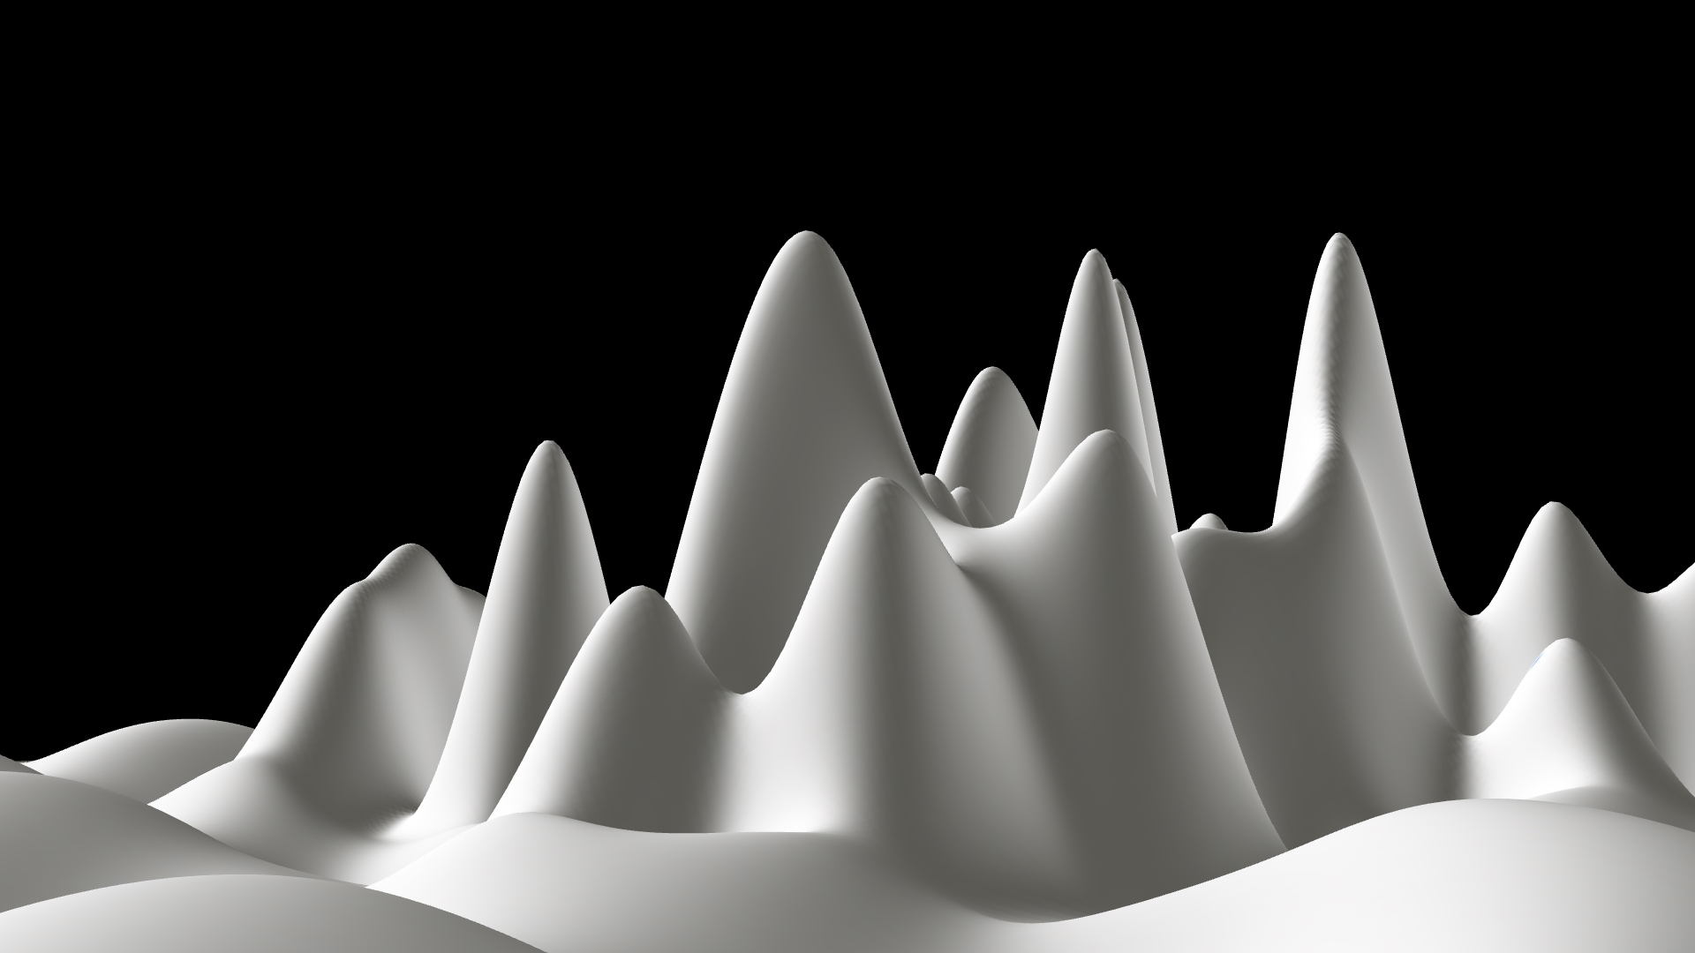
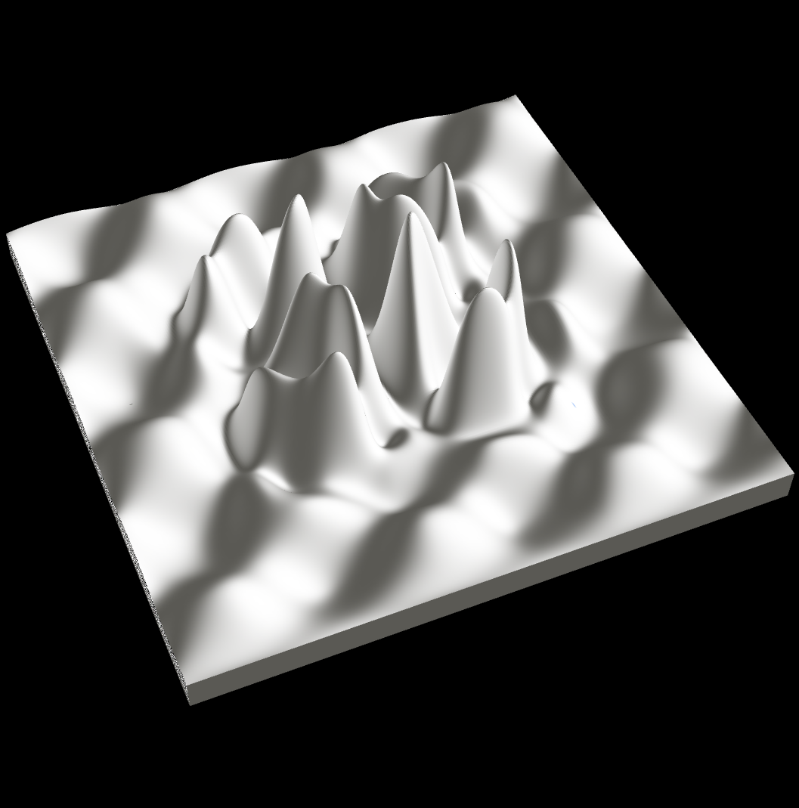
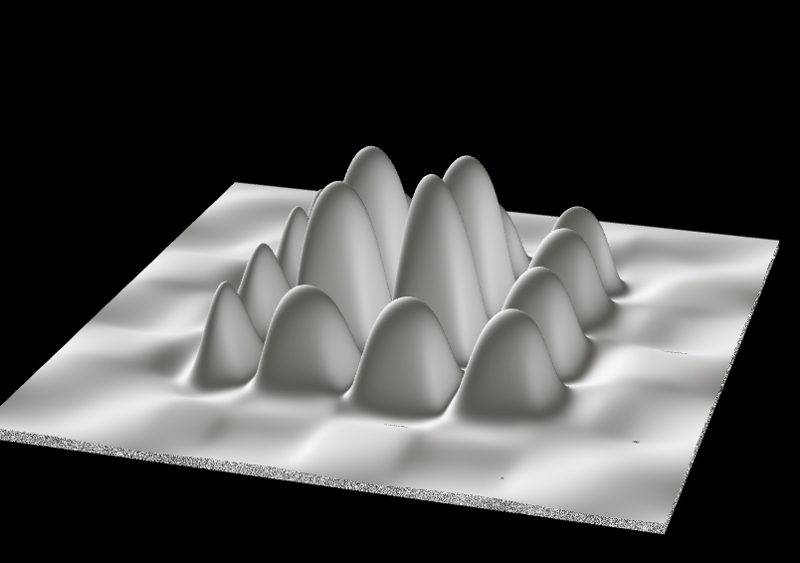
P5
<Computational Design Thinking>
<Parametric Design>
P5
1/2
<Aesthetic Designs>
This page is to showcase the various other designs that surfaced and from different point of view.
Like for example picture 2 gives you the impression that you are standing in front of a mountain in the void which gives sort of mystic feel
1/2
1/2
Captions
01 Aesthetic Designs 1
02 Aesthetic Designs 2
03 First person in the mountain ranges
02
01
03

